Slide 1
על מה נדבר היום ?
1. פיתוח ותשתיות , יכולים לעבוד יחדיו ?
2. קונפליקטים וגישות
3. צמצום החיכוכים בין הצוותים
4. הצגת פתרון לדוגמא

Slide 2
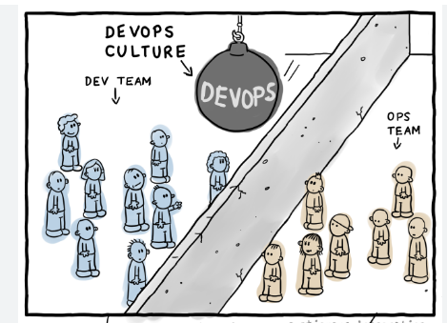

Slide 3
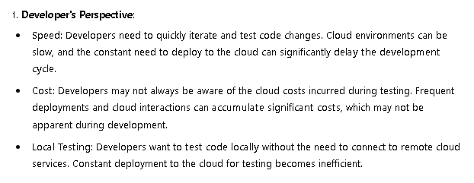




Slide 4
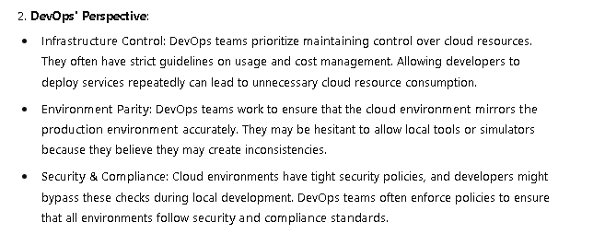

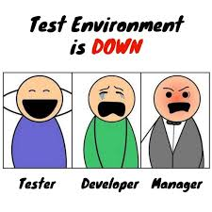


Slide 5
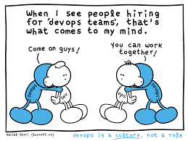

Slide 6
הלנצח נחיה על חרבנו ?

Slide 7
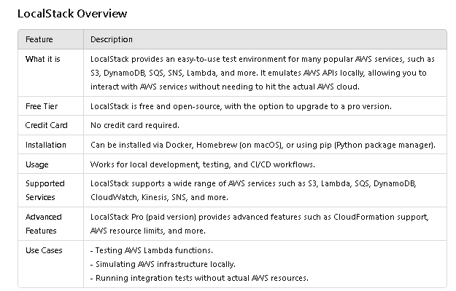

Slide 8
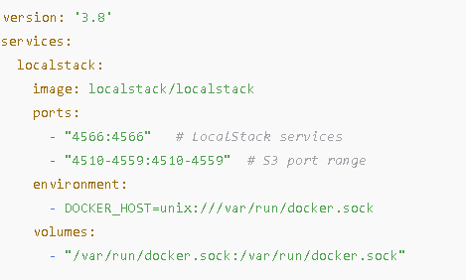
Install LocalStack via Docker
docker-compose.yml
curl http://localhost:4566/_localstack/health

Slide 9
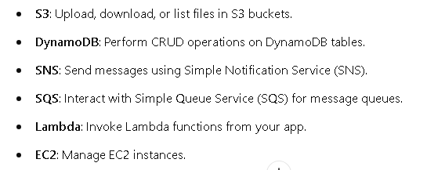
Install Node.js and Dependencies
Create the node project and install dependencies: npm init –y
npm install aws-sdk
Key Points About aws-sdk:
The SDK acts as a client that you can use to interact with AWS services.
It abstracts the underlying HTTP requests and provides a simple interface for working with AWS services.

Slide 10
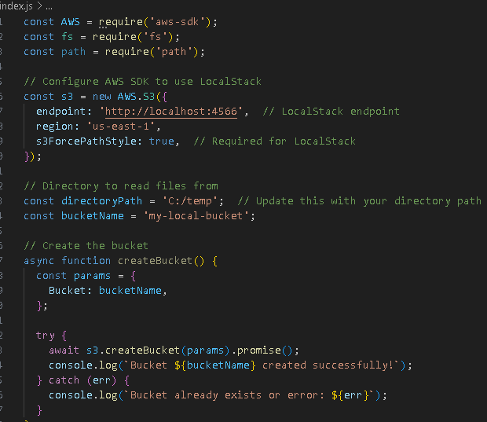

Slide 11
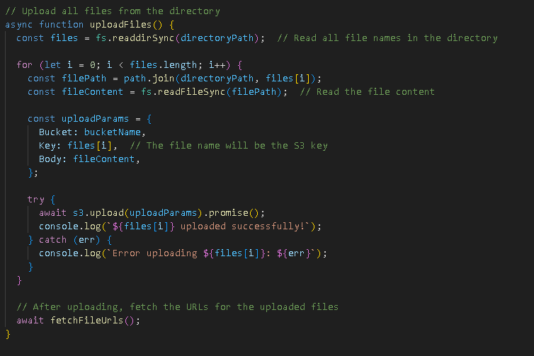
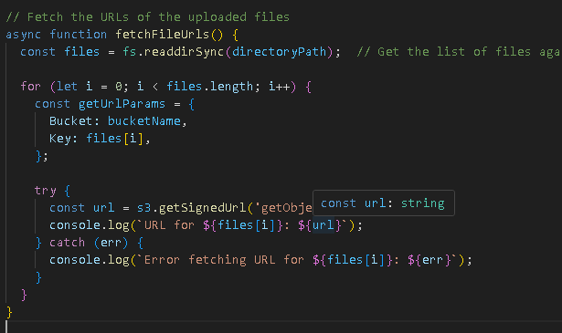

Slide 12
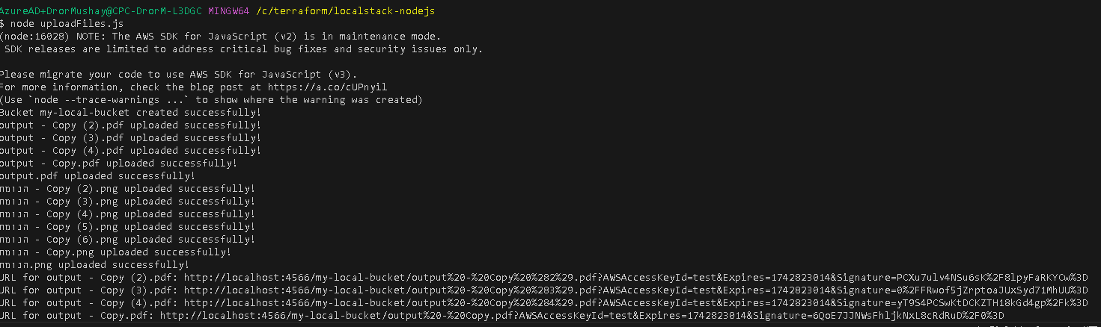
Make sure LocalStack is running in Docker by executing
docker run --rm -p 4566:4566 -e DOCKER_HOST=unix:///var/run/docker.sock localstack/localstack
Run the uploadFiles.js script

Slide 13
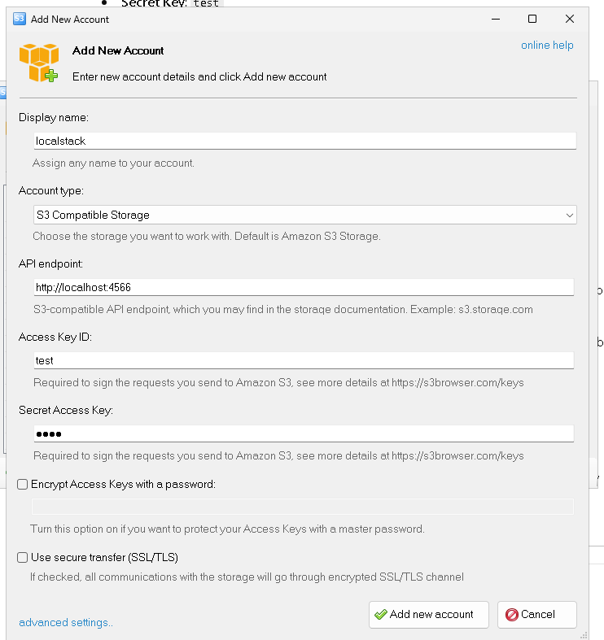
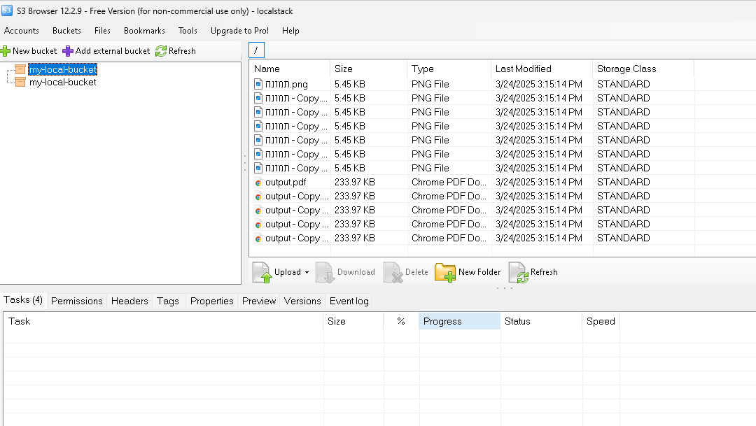

Slide 14
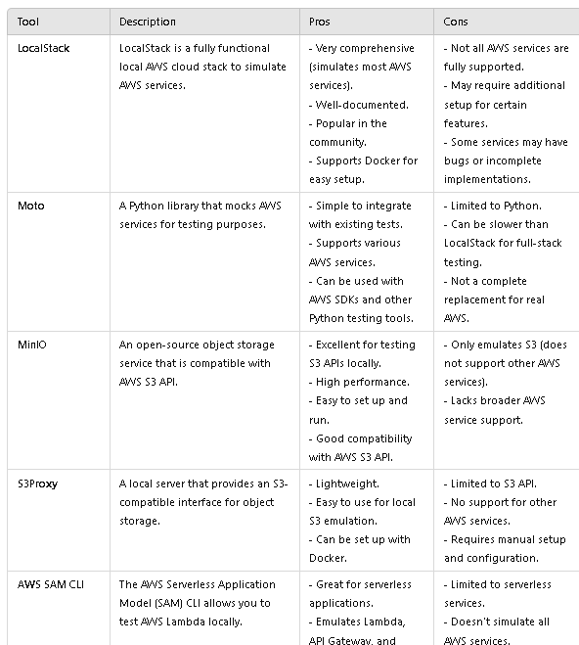
Alternatives

Slide 15
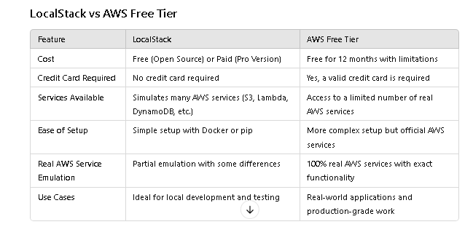

Slide 16
Conclusion:
LocalStack is a powerful tool for developers who want to simulate AWS services locally.
It provides an easy and cost-effective way to test AWS-based applications offline.
However, it’s not a replacement for real AWS infrastructure and is not recommended for production use.
For testing and local development, LocalStack is an excellent option, and you can combine it with AWS SDKs and CLI for a fully local AWS environment.

Slide 17

